Slide 1
Energy Efficiency Labelling
Potential Applications in the Region
Marco Pinzon
Programme Officer - UNEP

Slide 2
Labelling
Problem
Health
Nutrition
Consum
Awareness
Consciousness
Manuf
Improved products
Information of new characteristics
Environment
D
S1
S2
S4
S3

Slide 3
Labelling
Problem
Health
Nutrition
Consum
Awareness
Consciousness
Manuf
Improved products
Information of new characteristics
Environment
D
S1
S2
S4
S3

Slide 4
Labelling
Problem
Health
Nutrition
Consum
Awareness
Consciousness
Manuf
Improved products
Information of new characteristics
Environment
D
S1
S2
S4
S3

Slide 5
Environmental labels and declarations (ISO 14020 s)
Type I
Fulfillment of a set of criteria
Type II
Claims by manufacturers to inform
Self-declarations
Type III
Quantitative Environmental data declarations
Independent verification (LCA)
Third party verification (LCA)
Mark or logo awarded

Slide 6
Energy Efficiency Labels
Problem
Environment
Consum
Awareness
Consciousness
Manuf
Improved appliances
Information of new characteristics
D
S1
S2
S4
S3

Slide 7
Energy Efficiency Labels
Problem
Environment
Consum
Awareness
Consciousness
Manuf
Improved appliances
Information of new characteristics
D
S1
S2
S4
S3

Slide 8
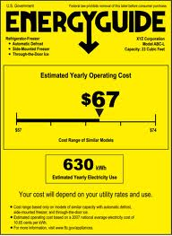
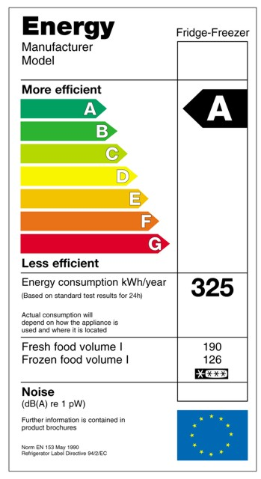
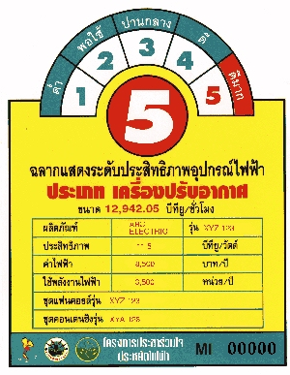
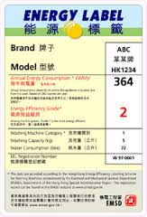
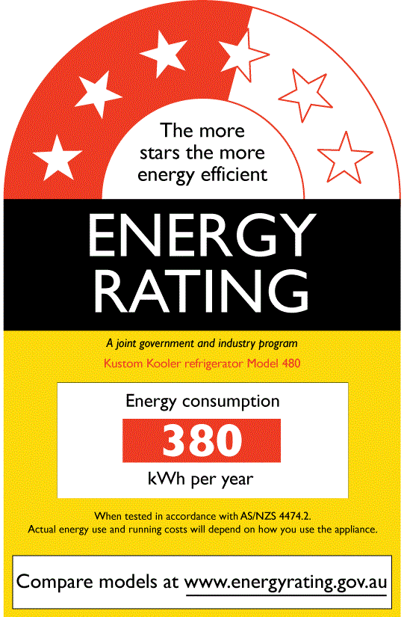
Some Energy Efficiency Labels

Slide 9
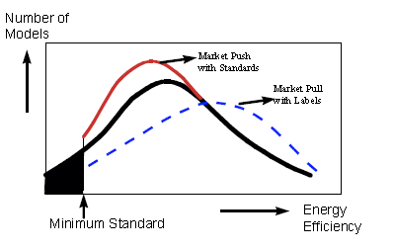
Labels ‘pull’ the market
*
* North American Energy Efficiency Standards and Labelling, North American Energy Working Group, 2002.

Slide 10
Thank you!

